Slide 1
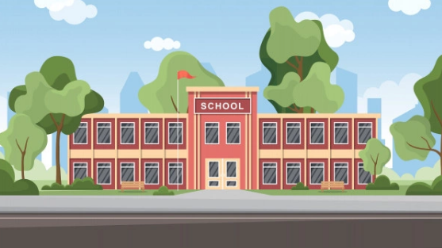
El Salam Secondary School Database
عمل الطلاب:
team 11
-نور اميل كمال مرزوق
-هادي جمال صادق
-وليد سيد ابوعابد غيط
-نور الدين عبدالله الحسن
-محمد مصطفي عبدالسميع علي
تحت اشراف: -د\ابراهيم العوضي -م\سلمي جمعة

Slide 2
Project Description:
We are doing a school database for El Salam Secondary School.
We added the needed information about the students, teachers, and workers to make a good and easy-to-use database.

Slide 3
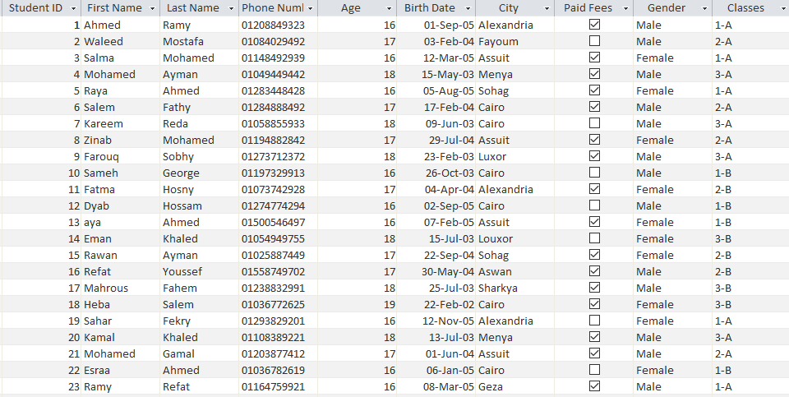
Student Table:

Slide 4
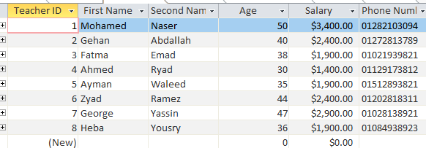
Teacher Table:

Slide 5
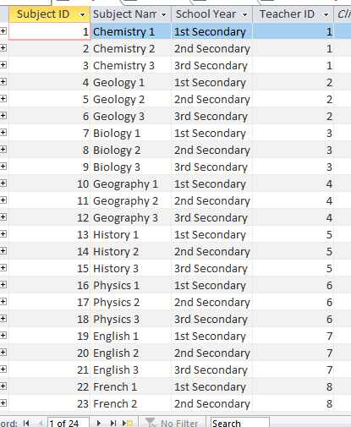
Subject Table:

Slide 6
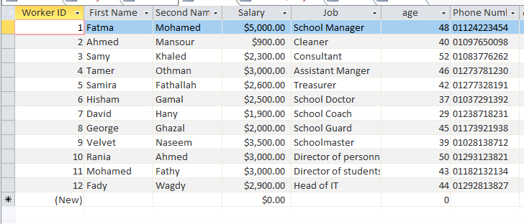
Workers Table:

Slide 7
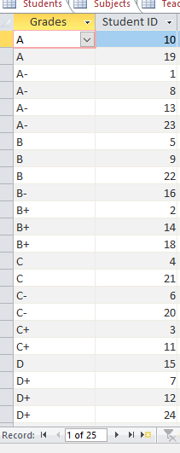
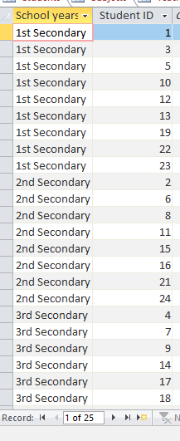
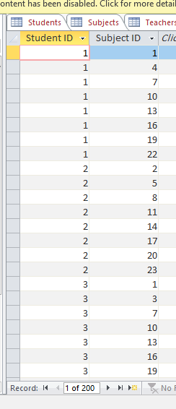
Grades, Levels and Student/Subject Tables:

Slide 8
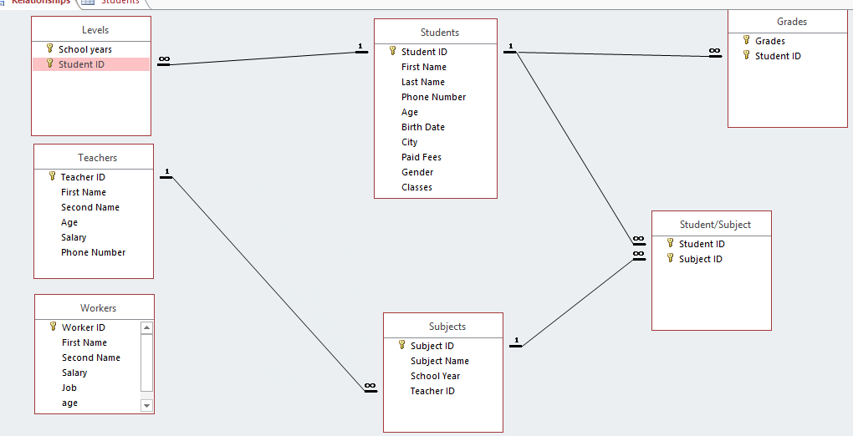
ERD:

Slide 9
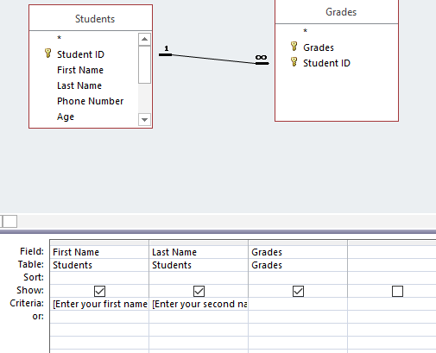

Queries:
We added a query for the student to get his/her Grade using their name
Result:

Slide 10
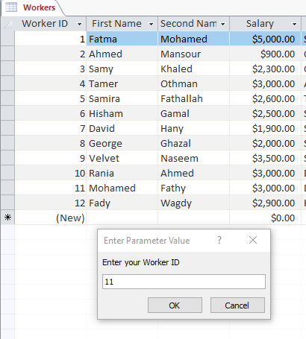

Queries:
We did a query to show Salary based on the worker’s ID:
Result:

Slide 11
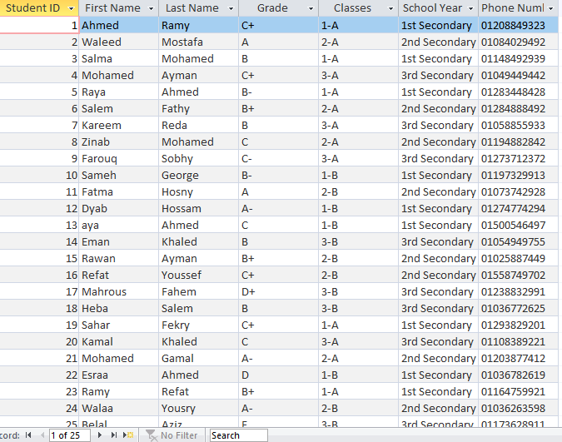
Queries:
We did a query to show the only the most important student information:

Slide 12
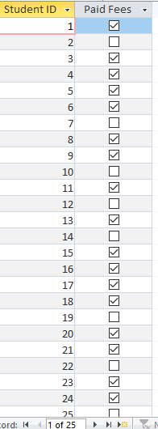
Queries:
We did a query to show whether the student has paid his school fees or not:

Slide 13
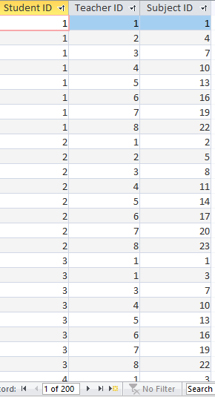
Queries:
We added a query to show the relation between students, teachers and subjects using their IDs:

Slide 14
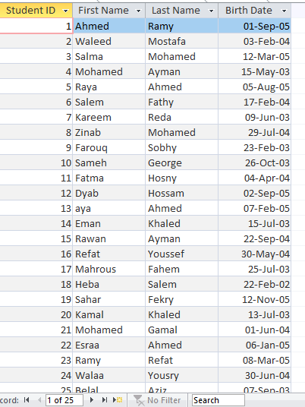
Queries:
We did a query to show students birthdays to know when to celebrate them:

Slide 15
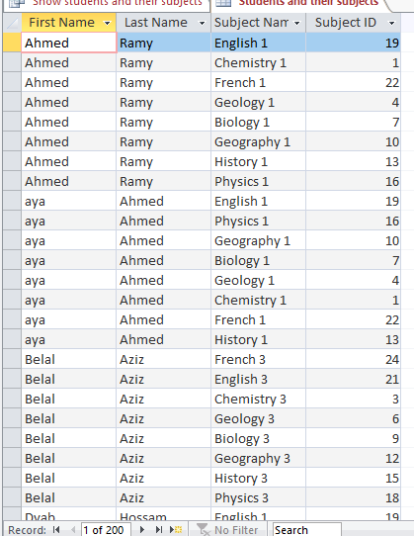
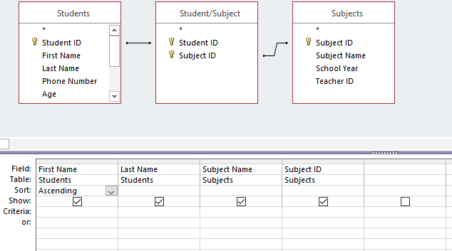
Queries:
We did a query that makes a new table that contains students’ IDs, names and phone numbers:
Result:----------------------------------------->>>

Slide 16
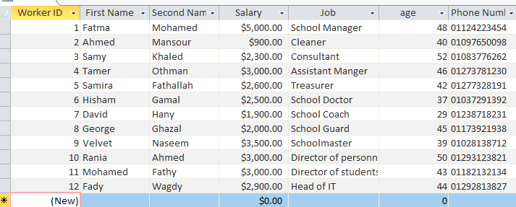
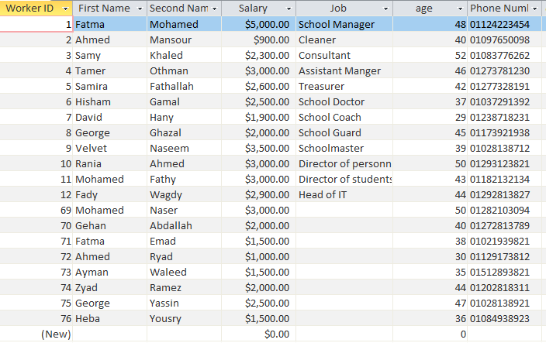
Queries:
We added an append query that adds teachers to workers table:
Before: -After:

Slide 17
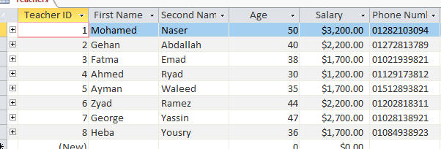
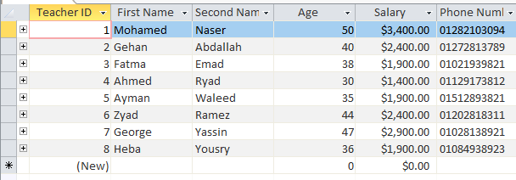
Queries:
We did a query to update teachers salary and increase it by 200:
Before: -After:

Slide 18
Queries:
We did a query that deletes the workers table:

Slide 19
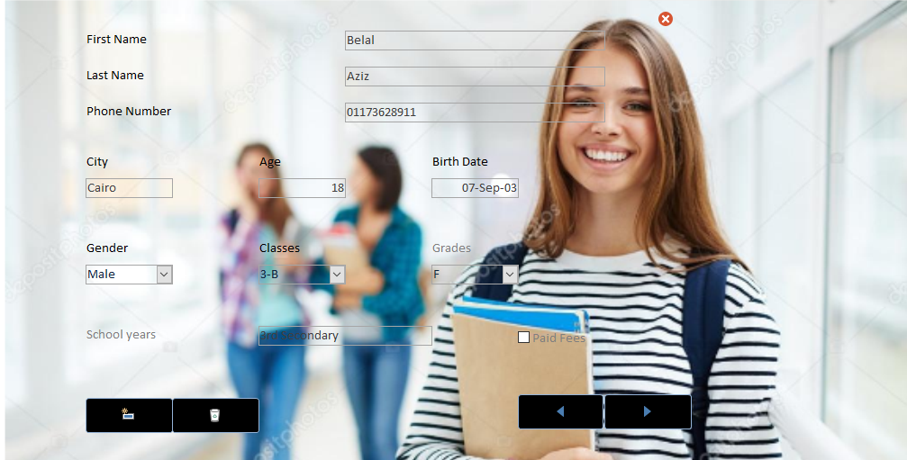
Student Form:

Slide 20
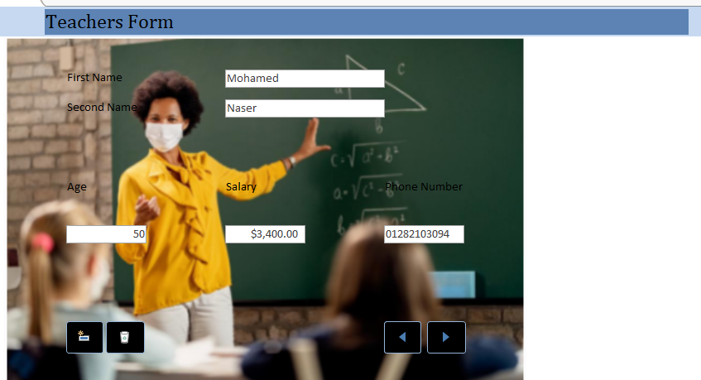
Teacher form

Slide 21
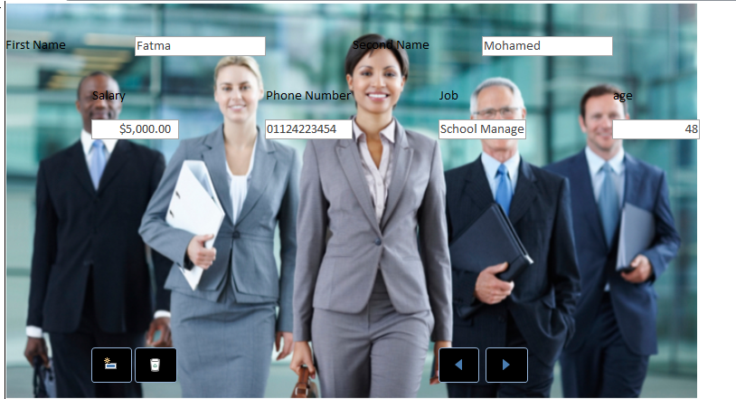
Workers Form:

Slide 22
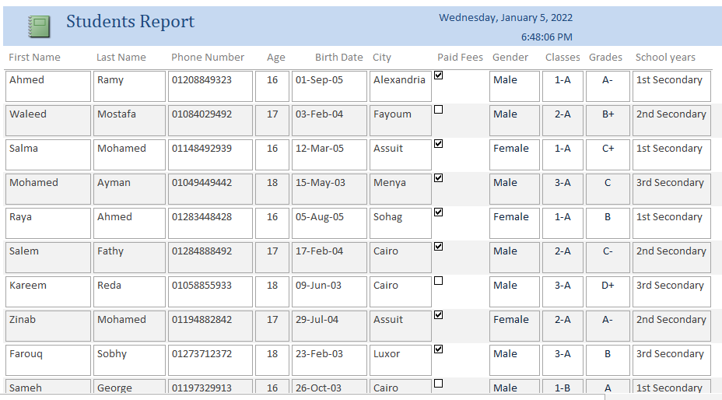
Students Report:

Slide 23
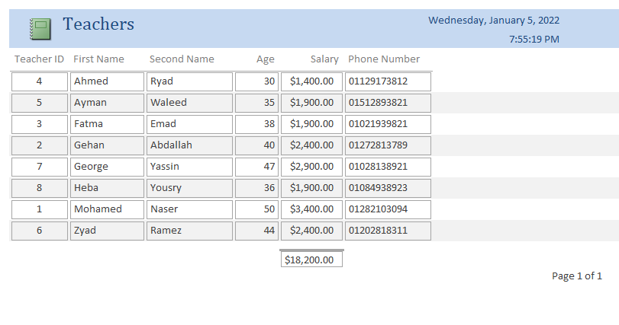
Teachers Report:

Slide 24
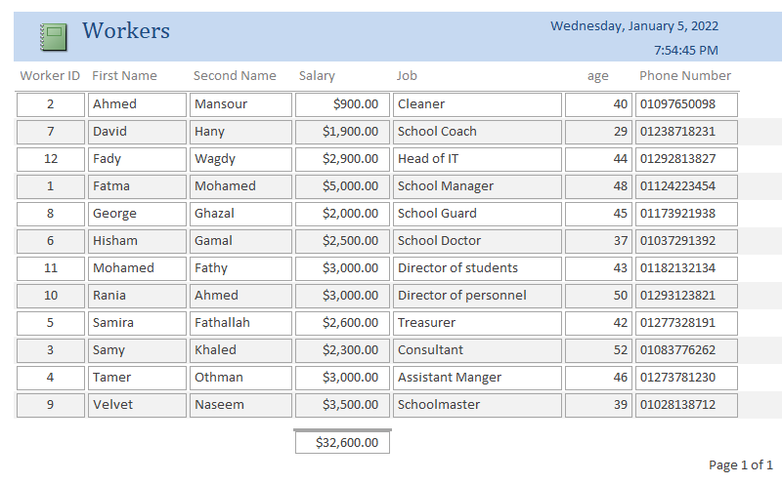
Workers Report:

Slide 25
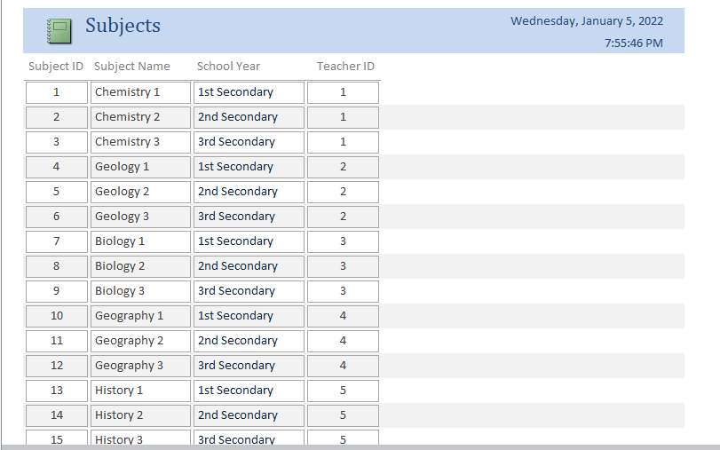
Subject Report:

Slide 26
GitHub Link:
https://github.com/nooremeel/Team-11-IS-School-Database.git

